Slide 1

CHAPTER 12
REGULAR
EXPRESSIONS
AND FINITE-STATE
AUTOMATA
Copyright © Cengage Learning. All rights reserved.

Slide 2
SECTION 12.1
Formal Languages and Regular Expressions
Copyright © Cengage Learning. All rights reserved.

Slide 3
Formal Languages and Regular Expressions
An English sentence can be regarded as a string of words, and an English word can be regarded as a string of letters.
Not every string of letters is a legitimate word, and not every string of words is a grammatical sentence.
We could say that a word is legitimate if it can be found in an unabridged English dictionary and that a sentence is grammatical if it satisfies the rules in a standard English grammar book.

Slide 4
Formal Languages and Regular Expressions
Computer languages are similar to English in that certain strings of characters are legitimate words of the language and certain strings of words can be put together according to certain rules to form syntactically correct programs.
A compiler for a computer language analyzes the stream of characters in a program—first to recognize individual word and sentence units (this part of the compiler is called a lexical scanner), then to analyze the syntax, or grammar, of the sentences (this part is called a syntactic analyzer), and finally to translate the sentences into machine code (this part is called a code generator).

Slide 5
Formal Languages and Regular Expressions
In computer science it has proved useful to look at languages from a very abstract point of view as strings of certain fundamental units and allow any finite set of symbols to be used as an alphabet.
It is common to denote an alphabet by a capital Greek sigma: Σ. (This just happens to be the same symbol as the one used for summation, but the two concepts have no other connection.)

Slide 6
Formal Languages and Regular Expressions
The definition of a string of characters of an alphabet Σ (or a string over Σ) is a generalization of the definition of string introduced earlier.
A formal language over an alphabet is any set of strings of characters of the alphabet.

Slide 7
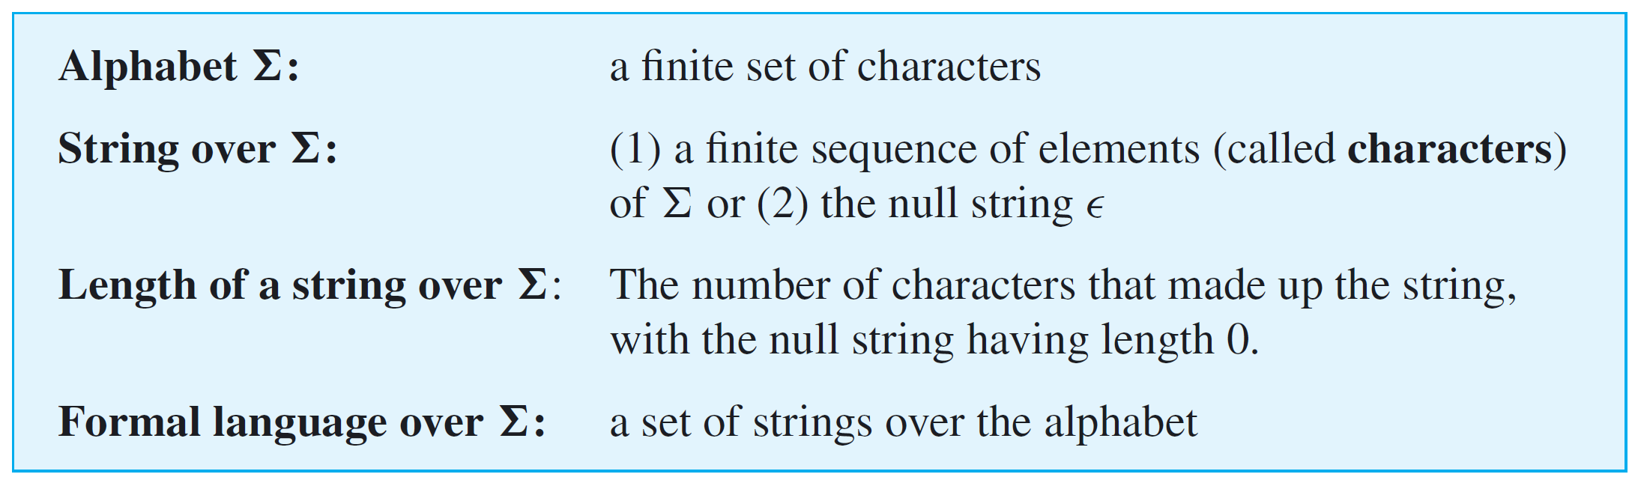
Formal Languages and Regular Expressions
These definitions are given formally as:
Note that the empty set satisfies the criteria for being a formal language. Allowing the empty set to be a formal language turns out to be convenient in certain technical situations.

Slide 8
Example 1 – Examples of Formal Languages
Let the alphabet Σ = {a, b}.
a. Define a language L₁ over Σ to be the set of all strings that begin with the character a and have length at most three characters. Find L₁.
b. A palindrome is a string that looks the same if the order of its characters is reversed.
For instance, aba and baab are palindromes. Define a language L₂ over Σ to be the set of all palindromes obtained using the characters of Σ. Write ten elements of L₂.

Slide 9
Example 1 – Solution
a. L₁ = {a, aa, ab, aaa, aab, aba, abb}
b. L₂ contains the following ten strings (among infinitely many others):
∈, a, b, aa, bb, aaa, bab, abba, babaabab, abaabbbbbaaba

Slide 10
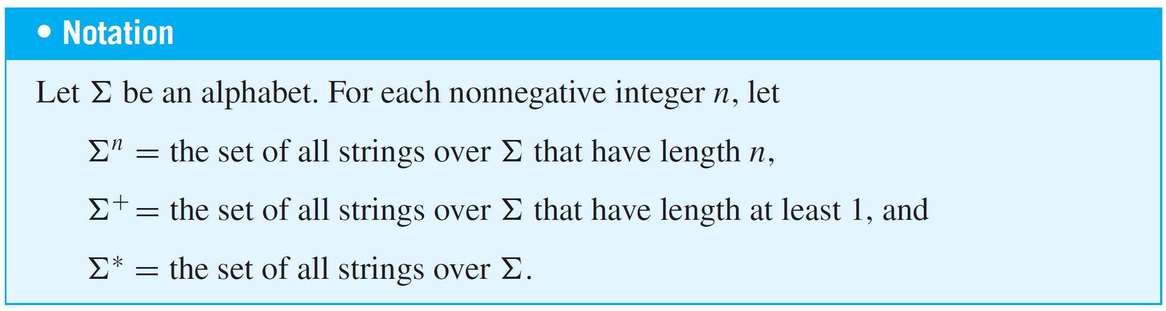
Formal Languages and Regular Expressions
Note that Σ^{n} is essentially the Cartesian product of n copies of Σ.
The language Σ∗ is called the Kleene closure of Σ, in honor of Stephen C. Kleene (pronounced CLAY-knee). Σ⁺ is the set of all strings over Σ except for ∈ and is called the positive closure of Σ.

Slide 11


Example 3 – Polish Notation: A Language Consisting of Postfix Expressions
An expression such as a b, in which a binary operator such as sits between the two quantities on which it acts, is said to be written in infix notation.
Alternative notations are called prefix notation (in which the binary operator precedes the quantities on which it acts) and postfix notation (in which the binary operator follows the quantities on which it acts).
In prefix notation, a b is written ab.
In postfix notation, a b is written ab .

Slide 12
Example 3 – Polish Notation: A Language Consisting of Postfix Expressions
cont’d
Prefix and postfix notations were introduced in 1920 by the Polish mathematician Jan Łukasiewicz (pronounced Wu-cash-AY-vich).
In his honor—and because some people have difficulty pronouncing his name—they are often referred to as Polish notation and reverse Polish notation, respectively.
A great advantage of these notations is that they eliminate the need for parentheses in writing arithmetic expressions.

Slide 13
Example 3 – Polish Notation: A Language Consisting of Postfix Expressions
cont’d
For instance, in postfix (or reverse Polish) notation, the expression 8 4 6 / is evaluated from left to right as follows:
Add 8 and 4 to obtain 12, and then divide 12 by 6 to obtain 2. As another example, if the expression (a b)  c in infix notation is converted to postfix notation, the result is ab c .

Slide 14
Example 3 – Polish Notation: A Language Consisting of Postfix Expressions
cont’d
a. If the expression ab  cd  in postfix notation is converted to infix notation, what is the result?
b. Let Σ = {4, 1, , −}, and let L = the set of all strings over Σ obtained by writing either a 4 or a 1 first, then either a 4 or a 1, and finally either a or a –.
List all elements of L between braces, and evaluate the resulting expressions.

Slide 15

Example 3 – Solution
a.
b.

Slide 16
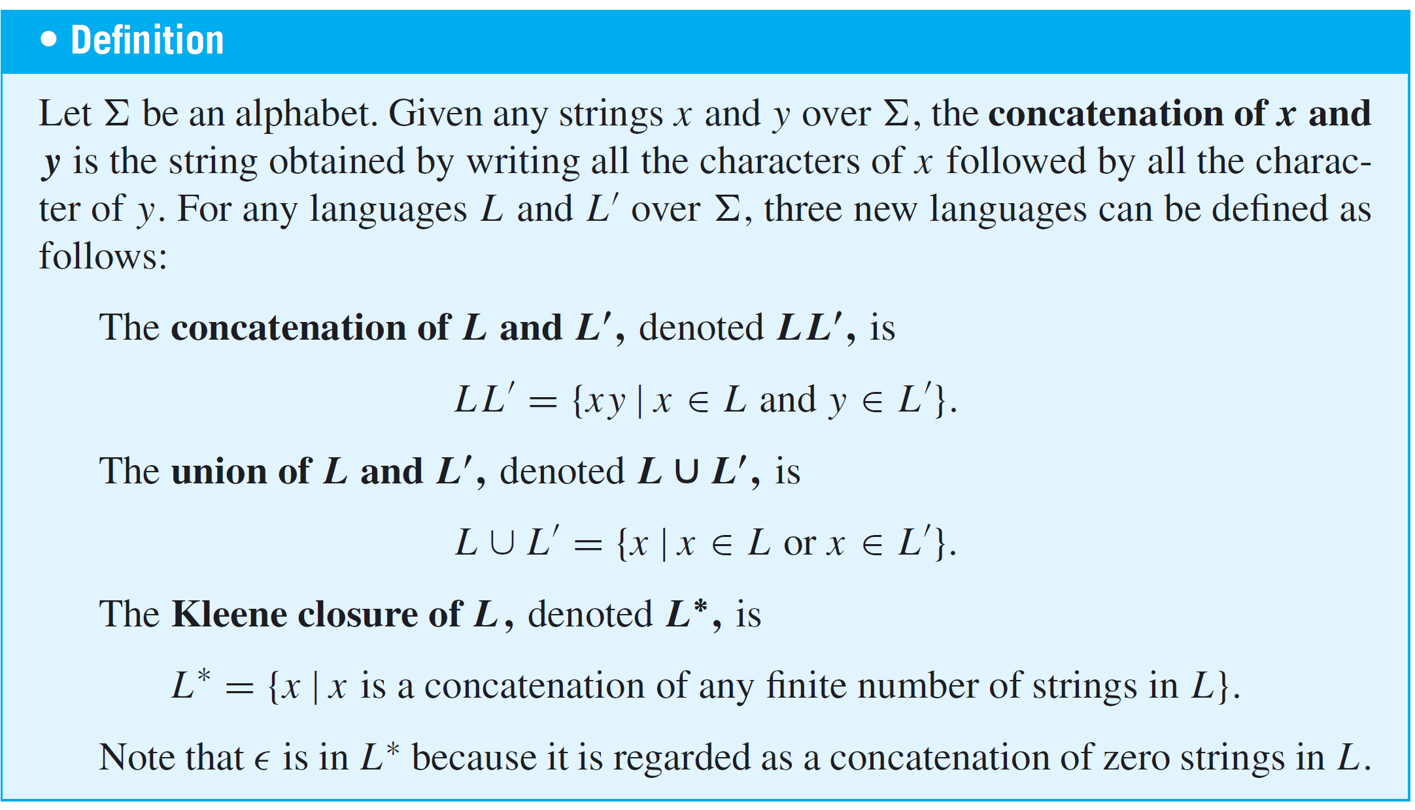
Formal Languages and Regular Expressions

Slide 17
The Language Defined by
a Regular Expression

Slide 18
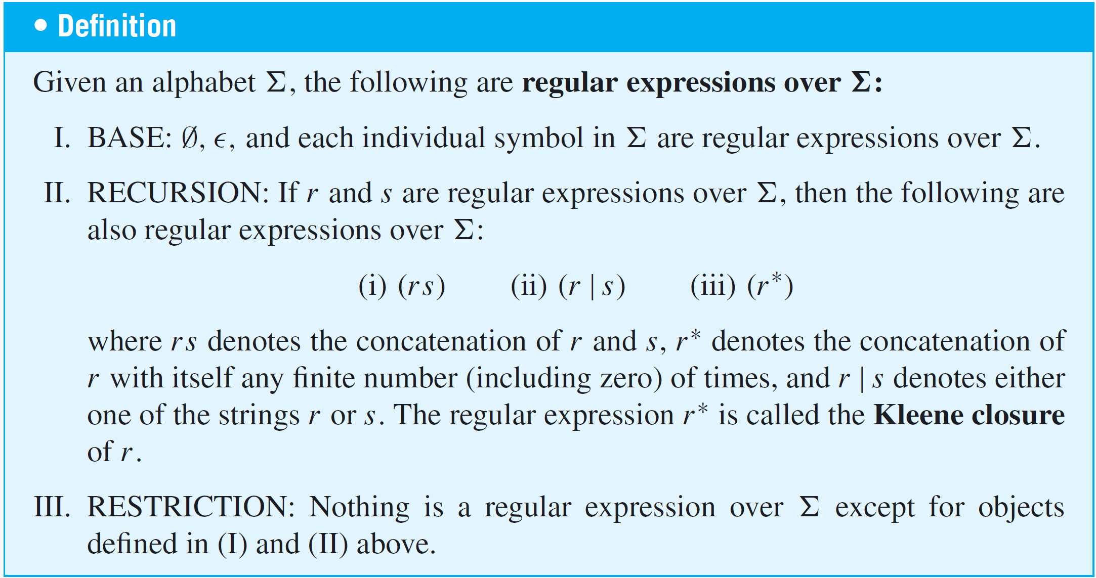
The Language Defined by a Regular Expression

Slide 19

The Language Defined by a Regular Expression
As an example, one regular expression over Σ = {a, b, c} is
If the alphabet happens to include symbols—such as ( | ) ∗—special provisions have to be made to avoid ambiguity.
An escape character, usually a backslash, is added before the potentially ambiguous symbol.
For instance, a left parenthesis would be written as \( and the backslash itself would be written as \\.

Slide 20
The Language Defined by a Regular Expression
To eliminate parentheses, an order of precedence for the operations used to define regular expressions has been introduced.
The highest is ∗, concatenation is next, and | is the lowest.
It is also customary to eliminate the outer set of parentheses in a regular expression, because doing so does not produce ambiguity.
Thus

Slide 21




Example 5 – Order of Precedence for the Operations in a Regular Expression
a. Add parentheses to make the order of precedence clear in the following expression:
b. Use the convention about order of precedence to eliminate the parentheses in the following expression:
Solution:
a.
b.

Slide 22
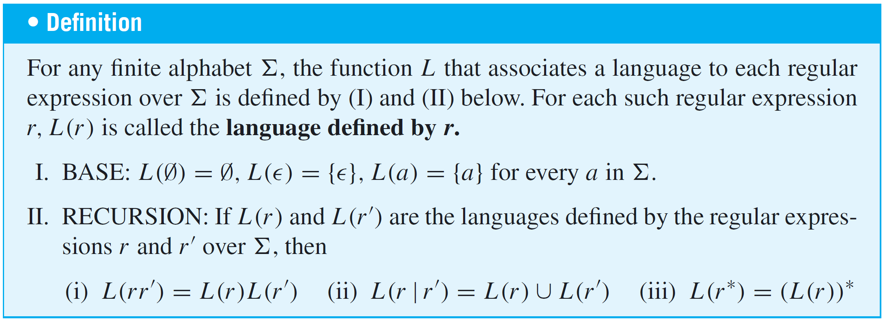
The Language Defined by a Regular Expression
Given a finite alphabet, every regular expression r over the alphabet defines a formal language L(r). The function L is defined recursively.

Slide 23
The Language Defined by a Regular Expression
Note that any finite language can be defined by a regular expression.
For instance, the language {cat, dog, bird} is defined by the regular expression (cat | dog | bird).

Slide 24



Example 6 – Using Set Notation to Describe the Language Defined by a Regular Expression
Let Σ = {a, b}, and consider the language defined by the regular expression (a | b)∗.
Use set notation to find this language, and describe it in words.
Solution:
The language defined by (a | b)∗ is

Slide 25

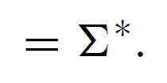
Example 6 – Solution
cont’d

Slide 26
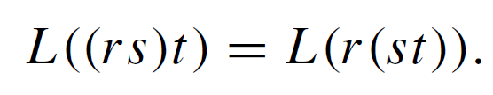
The Language Defined by a Regular Expression
Note that concatenating strings and taking unions of sets are both associative operations. Thus for any regular expressions r, s and t,
Moreover,

Slide 27
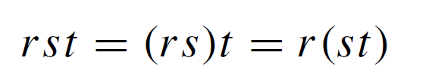

The Language Defined by a Regular Expression
Because of these relationships, it is customary to drop the parentheses in “associative” situations and write
and

Slide 28
Practical Uses of Regular Expressions

Slide 29
Practical Uses of Regular Expressions
Many applications of computers involve performing operations on pieces of text.
For instance, word and text processing programs allow us to find certain words or phrases in a document and possibly replace them with others.
A compiler for a computer language analyzes an incoming stream of characters to find groupings that represent aspects of the computer language such as keywords, constants, identifiers, and operators.

Slide 30
Practical Uses of Regular Expressions
And in bioinformatics, pattern matching and flexible searching techniques are used extensively to analyze the long sequences of the characters A, C, G, and T that occur in DNA.
Through their connection with finite-state automata, regular expressions provide an extremely useful way to describe a pattern in order to identify a string or a collection of strings within a piece of text.
Regular expressions make it possible to replace a long, complicated set of if-then-else statements with code that is easy both to produce and to understand.

Slide 31
Practical Uses of Regular Expressions
Because of their convenience, regular expressions were introduced into a number of UNIX utilities, such as grep (short for globally search for regular expression and print) and egrep (extended grep), in text editors, such as QED (short for Quick EDitor, the first text editor to use regular expressions), vi (short for visual interface), sed (short for stream editor and originally developed for UNIX but now used by many systems), and Emacs (short for Editor macros), and in the lexical scanner component of a compiler.

Slide 32
Practical Uses of Regular Expressions
The computer language Perl has a particularly powerful implementation for regular expressions, which has become a de facto standard. The implementations used in Java and .NET are similar.
A number of shorthand notations have been developed to facilitate working with regular expressions in text processing.

Slide 33

Practical Uses of Regular Expressions
When characters in an alphabet or in a part of an alphabet are understood to occur in a standard order, the notation [beginning character– ending character] is commonly used to represent the regular expression that consists of a single character in the range from the beginning to the ending character.
It is called a character class. Thus
and

Slide 34
Practical Uses of Regular Expressions
Character classes are also allowed to include more than one range of characters. For instance,
As an example, consider the language defined by the regular expression
The following are some strings in the language:
Account Number, z23, jsmith109, Draft2rev.

Slide 35
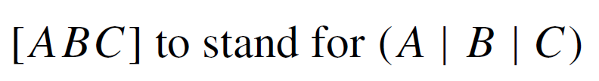
Practical Uses of Regular Expressions
In general, the language is the set of all strings that start with a letter followed by a sequence of digits or letters.
This set is the same as the set of allowable identifiers in a number of computer languages.
Other commonly used shorthands are
and a single dot
. to stand for an arbitrary character.
Thus, for instance, if Σ = {A, B,C}, then

Slide 36
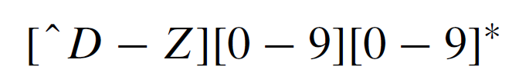

Practical Uses of Regular Expressions
When the symbol ^ is placed at the beginning of a character class, it indicates that a character of the same type as those in the range of the class is to occur at that point in the string, except for one of the specific characters indicated after the ^ sign. For instance
stands for any string starting with a letter of the alphabet different from D to Z, followed by any positive number of digits from 0 to 9.
Examples are B3097,C0046, and so forth. If r is a regular expression, the notation denotes the concatenation of r with itself any positive finite number of times.

Slide 37


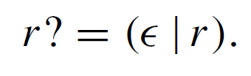
Practical Uses of Regular Expressions
In symbols,
For example,
represents any nonempty string of capital letters. If r is a regular expression, then
That is, r? denotes either zero occurrences or exactly one occurrence of r.

Slide 38
Practical Uses of Regular Expressions
Finally, if m and n are positive integers with m ≤ n,
r {n} denotes the concatenation of r with itself
exactly n times.
and
r {m, n} denotes the concatenation of r with itself
anywhere from m through n times.

Slide 39

Practical Uses of Regular Expressions
Thus a check to help determine whether a given string is a local telephone number in the United States is to see whether it has the form
or, equivalently, whether it has the form

Slide 40
Example 11 – A Regular Expression for a Date
People often write dates in a variety of formats. For instance, in the United States the following all represent the fifth of February of 2050:
Write a regular expression that would help check whether a given string might be a valid date written in one of these forms.

Slide 41

Example 11 – Solution
The language defined by the following regular expression consists of all strings that begin with one or two digits followed by either a hyphen or a slash, followed by either one or two digits, followed by either a hyphen or a slash, followed by four digits.
All valid dates of the given format are elements of the language defined by this expression, but the language also includes strings that are not valid dates.

Slide 42
Example 11 – Solution
cont’d
For instance, 09/54/1978 is in the language, but it is not a valid date because September does not have 54 days, and 38/12/2184 is not valid because there is no 38th month.
It is possible to write a more complicated regular expression that could be used to check all aspects of the validity of a date, but the kind of simpler expression given above is nonetheless useful.
For instance, it provides an easy way to notify a user of an interactive program that a certain kind of mistake was made and that information should be reentered.

